Slide 1
The Value
of Education

Slide 2
Value of Education
These figures show that for the average person, finishing high school is worth about $10,000 more (compared with dropping out). And finishing college nearly doubles the worth of that number to $22,000 more!
Notes:
http://hsfpp.nefe.org/loadFile.cfm?contentid=325 Student guide page 100

Slide 3
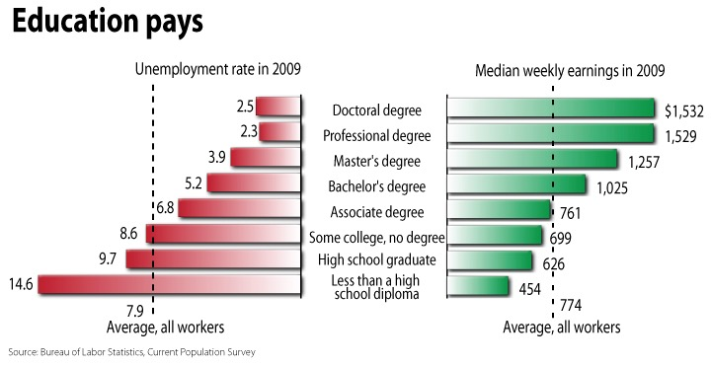
Uneducated = Unemployed Education pays in higher earnings and lower unemployment rates
Source: www.bls.gov: Employment statistics of the civilian population 25 years and over by educational attainment.
Notes:
http://www.bls.gov/emp/ep_chart_001.htm

Slide 4
An Employer’s Perspective
“High school can be hard work. A high school dropout is probably scared of a little hard work.”
“Someone who couldn’t complete high school probably finds it difficult to complete any task.”
“A high school dropout didn’t learn some things that are needed to be good at this job!”
“How bright can a high school dropout be?”

Slide 5
Some Things About School Are So… Finish the sentence “Some things about school are so…” by listing those things about school you think are difficult or hard, those that are comfortable or so-so, and those that are easy for you.
Comfortable
Difficult
Comfortable
Comfortable
Comfortable
Comfortable
Easy
Difficult
Difficult
Difficult
Difficult
Difficult
Easy
Easy
What actions can you take to improve your ability and skill in areas you find difficult?
What is your plan of action, your timeline, for improvement?
Notes:
Finish the sentence “Some things about school are so…” by listing those things about school you think are difficult or hard, those that are comfortable or so-so, and those that are easy for you.

Slide 6
Calculate the difference between…
 | H.S. Dropout | H.S. Diploma | Associate’s Degree | Bachelor’s Degree | Advanced Degree
Annual Income | $19,226 | $28,950 | $36,395 | $51,568 | $67,073
Calculate the difference in salary between:
A high school dropout and a high school graduate.
A high school graduate and a graduate from a two-year college program (associate’s degree).
A two-year college graduate and a four-year college graduate (bachelor’s degree).
A four year college graduate and an individual with an advanced degree (master’s or doctorate).
Notes:
Source: U.S. Census Bureau, Current Population Survey, 2005 Annual Social and Economic Supplement

Slide 7
Calculate the lifetime earnings of each level of educational attainment using the table below. Have students assume each person works until 70 years of age. Other assumptions include:
The high school dropout begins full-time work at age 16.
The high school graduate begins full-time work at age 18.
The graduate of the two-year college begins full-time work at age 20.
The graduate of the four-year college begins full-time work at age 22.
The graduate with a master’s degree begins full-time work at age 24.
 | H.S. Dropout | H.S. Diploma | Associate’s Degree | Bachelor’s Degree | Advanced Degree
Annual Income | $19,226 | $28,950 | $36,395 | $51,568 | $67,073
Years Worked
Life Earnings
Notes:
Source: U.S. Census Bureau, Current Population Survey, 2005 Annual Social and Economic Supplement

Slide 8
Write three paragraphs summarizing what you have learned about careers and income. Include comments about employer’s perspectives and your feelings about school. Conclude with your educational goals and how they will influence your income.

